Slide 1

CMR Technical Campus Department of CSE
Real Time Research Project / Societal Related Project
Project Title: CMRTC CANTEEN WITH E-MENU CARD
Presented By:
Batch No: 16
H. No: 227R1A05J3 Name: SHIVA KUMAR
H. No: 227R1A05F7 Name: LONKA.SRIHITHA
H. No: 227R1A05J0 Name: RODDA.KARTHIK
Project Supervisor:
Name: MS.SIDDAMMA
Designation: Assistant professor

Slide 2
content
Abstract
Introduction
Literature Review
Objectives
Requirement Analysis
Methodology
Design/Architecture
References

Slide 3
Abstract
Restaurant owners have made various efforts to adopt information and communication technologies (ICT).
These technologies aim to enhance the dining experience.
It proposes a low-cost touchscreen-based Restaurant Management System using an Android smartphone or tablet as a solution
Key benefits:
Orders made by customers instantly reach the kitchen module.
The wireless application is user-friendly.
Improves efficiency and accuracy for restaurants.
Saves time and reduces human errors.Provides customer feedback.

Slide 4
Introduction
Electronic Menu with Recommendations
Lists menu categories and items
Customers can choose and pay online or in cash
Order Processing
Instant order notification to staff
Table booking feature
Efficiency and Service
Reduces wait time
Menu and prices managed by admin
User feedback improves
Service snd Database Management
Secure,
encrypted and data handling Monitored by authorized personnel

Slide 5
Literature Review
Objective
Develop an efficient system using radio frequency identification (RFID) to counter billing delays
Application
Suitable for large industries, universities, and government offices
Offers cost-effectiveness and quick, easy-to-use service
Benefits for Colleges
Fast food service to reduce paperwork and avoid long queues
Keeps operations organized
Canteen and Admin Management
Canteen updates order progress through a web application
Admin manages student and canteen data through the web application

Slide 6
Objectives
To develop a wireless network system for a better user experience with interactivity at restaurant.
To tailor the smooth operation with less delay and reduction in operational confusion.
To integrate technology and automation in the foodservice industry for efficiency .
To develop a cost-effective system that could work in small restaurants that are not willing to invest huge amounts of money in these systems.
To make more user interfaces friendly and customization for the restaurant owner to obtain a disciplined surrounding.

Slide 7
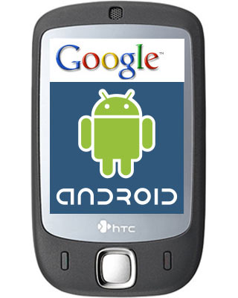


Requirement Analysis
HARDWARE
MICRO CONTROLLER (AT89S52)
POWER SUPPLYPC
Bluetooth Module
LCD Display
SOFTWARE
Android apk(Bluetooth terminal)
Arduino IDE
ISP
Git hub
Any Embedded C
cloud Platform(AWS)

Slide 8
Proposed Methodology
1.System Design and Requirements Gathering
2.Web application for canteen staff
3.Administartor Portal
4.Database management
5.Integration testing
6.Deployment

Slide 9
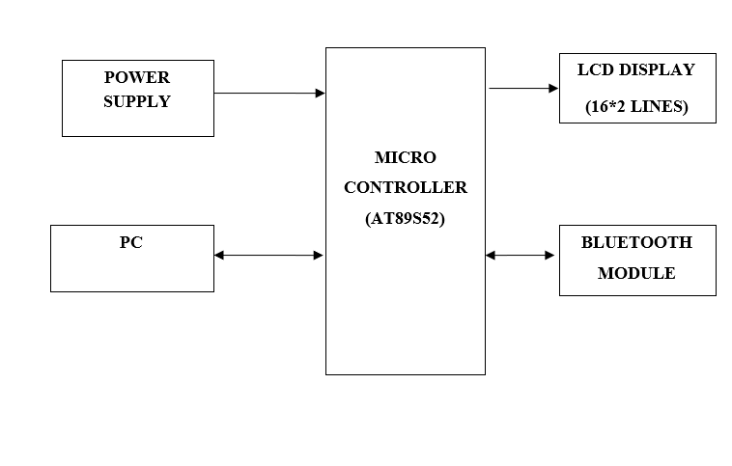
Design / Architecture

Slide 10
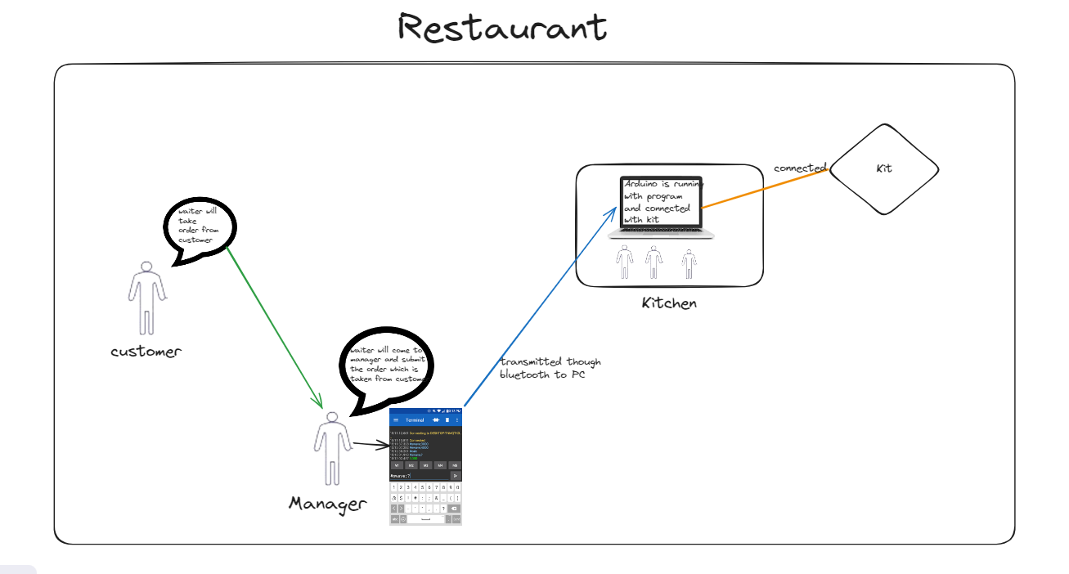
RESULTS & DISCUSSION

Slide 11
CONCLUSION AND FUTURE SCOPE

Slide 12
References
Hsieh, Y.-H., Chu, S.-I., & Lin, Y.-H. (2018). Evaluating the Usability of Tablets for E-Menu Applications in the Hospitality Industry. IEEE Access, 6, 31479-31487.
Suciuvskyte, D., & Iessmantaviccienee, V. (2020). The Role of QR Codes in Smart Restaurants. Economics and Business Studies, 8(4), 369-378.
Patil, B. B., Kale, S. B., & Patil, A. B. (2018). A Comparative Study of E-Menu Cards Using Wi-Fi and Bluetooth. International Journal of Innovative Technology and Exploring Engineering, 8(9S2), 689-693.
Cai, S. Y., Hong, Z. Z., & Lin, W. H. (2014). Design and Implementation of E-Menu Ordering System with Cashless Payment. International Journal of Future Computer and Communication, 3(2), 141-145.
Lim, S. H., Poo, W. S., & Tan, J. S. (2015). Security and Payment Methods for Mobile Point of Sale. IEEE, 978-1-4799-6962-7/15.

Slide 13

Q & A

Slide 14

Thank You

